Slide 1
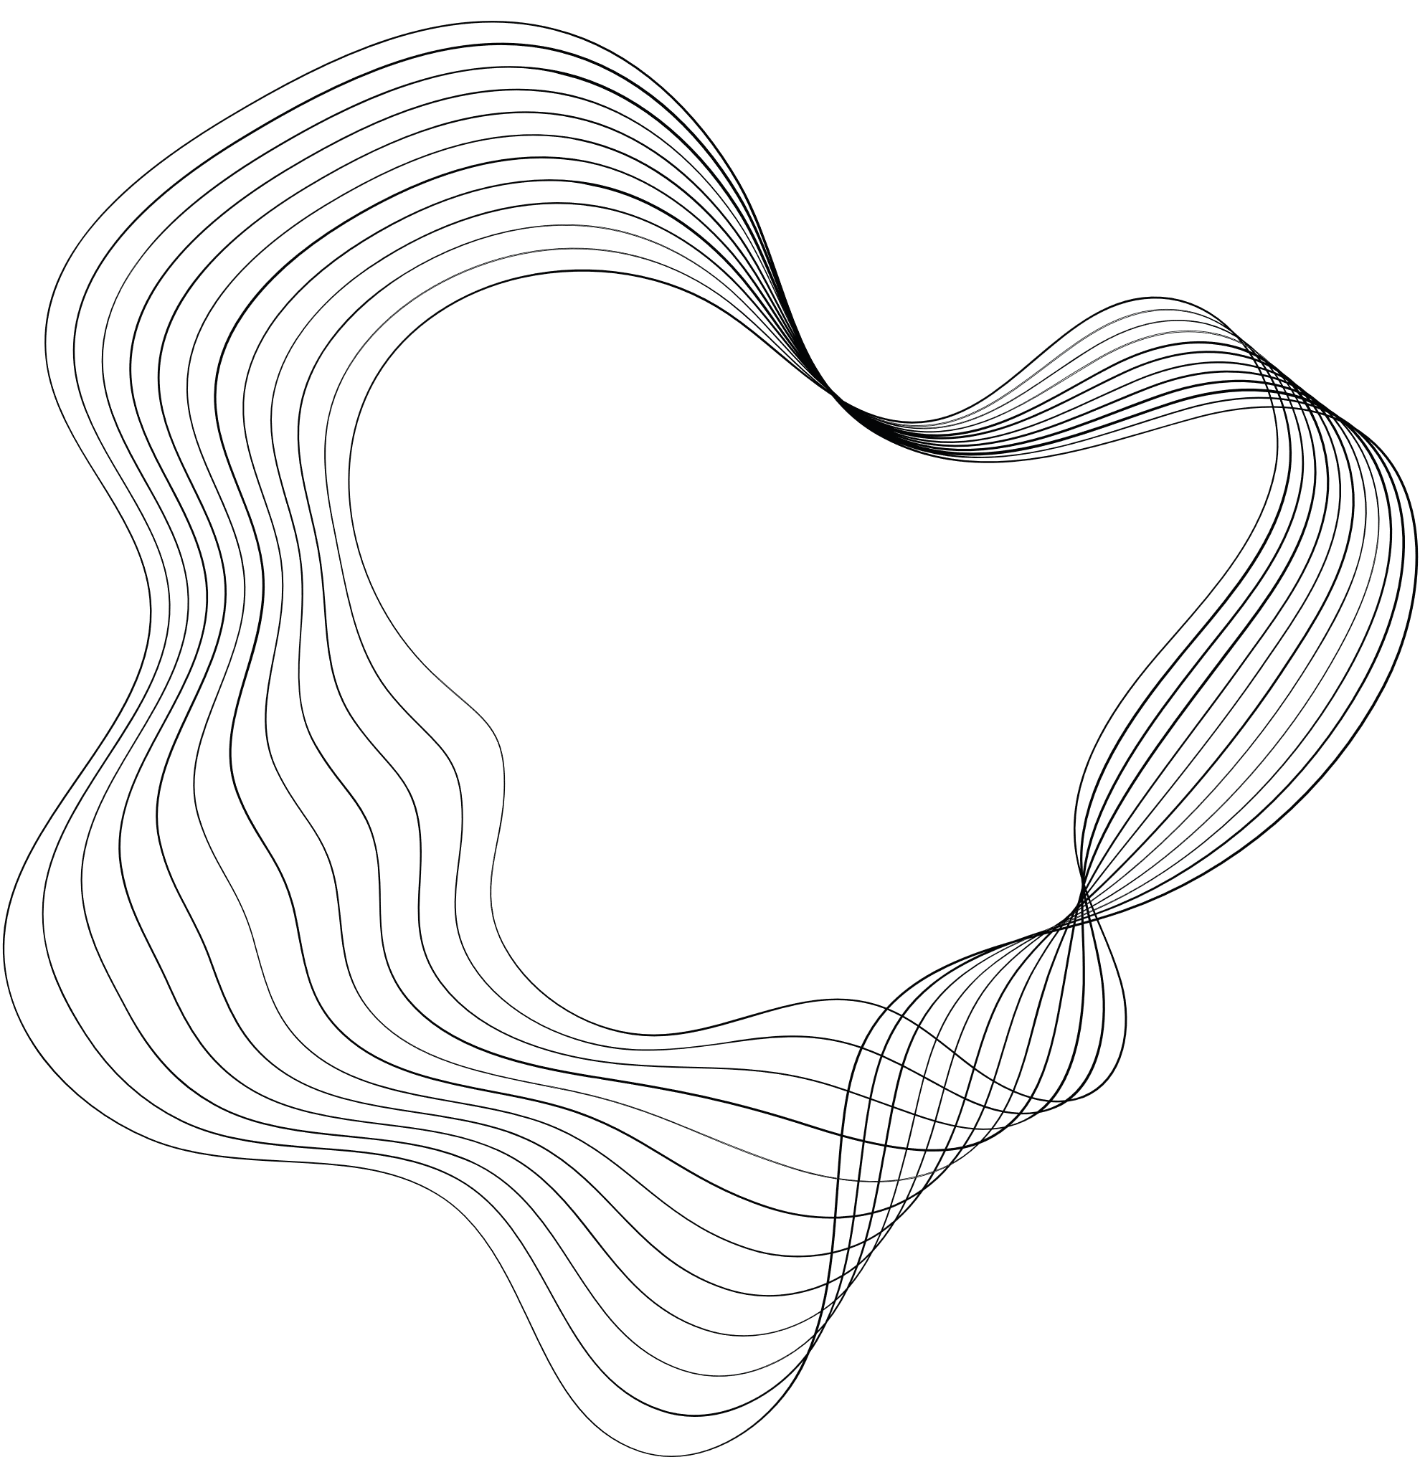

MSIS 5633
GROUP 15
ANALYSIS OF INJURY SEVERITY RISK FACTORS IN AUTOMOBILE CRASHES
TERM PROJECT PRESENTATION - SPRING 2024

Slide 2



TEAM MEMBERS
Karthik Bathini
Sunanda Sen
Chinmayi Rane
Graduate Student: Management Information Systems
Graduate Student: Business Analytics & Data Science
Graduate Student: Management Information Systems

Slide 3







PROJECT OVERVIEW
CRISP DM Methodology
Data Understanding
Data Modelling
Deployment
Business Understanding
Data Preparation
Evaluation

Slide 4
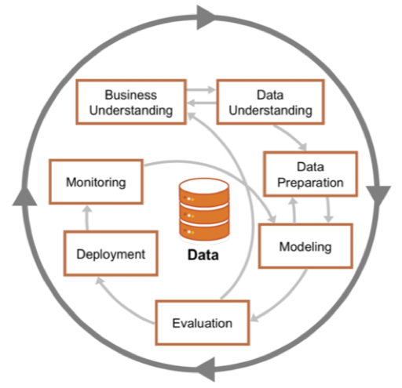
CRISP-DM METHODOLOGY

Slide 5





BUSINESS UNDERSTANDING
Government Agencies
Law Enforcement Agencies
Automobile Manufacturers
Insurance Companies
1.35 million people die
$1.9 trillion
50 million are injured
Public Health Organizations
Targeted Solutions
Analyze diverse dataset
Understand factors for severe injury
Reduce severe injuries from road crashes
Enhance road safety
Develop predictive models
Generate insights and solutions

Slide 6

DATA UNDERSTANDING
The data is sourced from the Crash Report Sampling System (CRSS), which gathers its data from a nationally representative probability sample selected from the more than 6 million police-reported crashes that occur annually in the United States.
SAS DATA FILES
Accident
Vehicle
Person
Distract

Slide 7

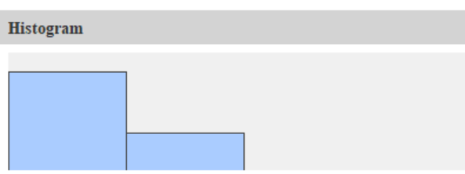
DATA UNDERSTANDING
Dependent Variable INJ_SEV
Distribution of INJ_SEV_binned
Describes the severity of injury sustained by individuals in a crash
8 attribute codes assigned to this variable
0 is no injury & 5,6,9 are unknown. These attributes were filtered out
Attribute code 1-2.5 were binned as low injury and 2.5-4 were binned as high injury
18936
4423
Low Injury
High Injury

Slide 8
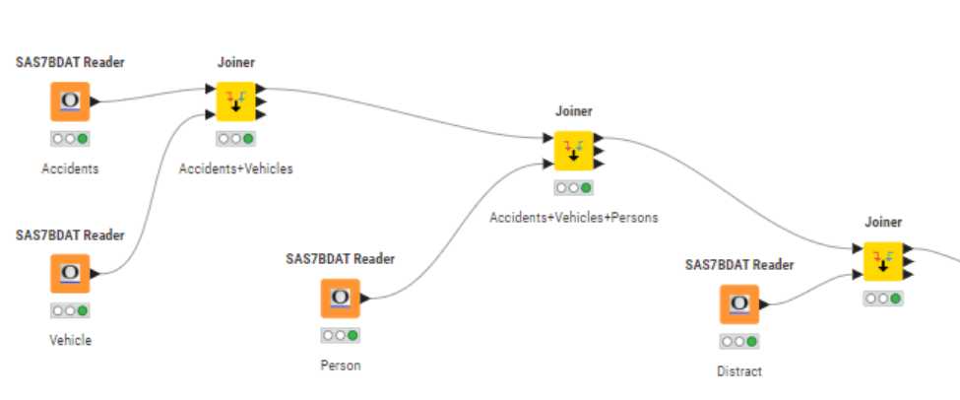
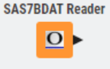

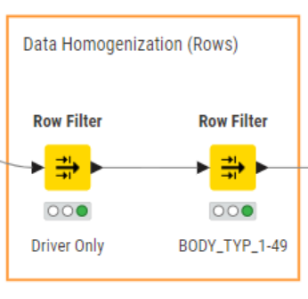
DATA PREPROCESSING
DATA JOINING & HOMOGENIZATION
The four datasets were read using the SAS7BDAT Reader node
The four data files were joined to create one comprehensive dataset.
Driver Focus: The analysis was limited to drivers by filtering the SEAT_POS variable to include only the driver's seat positions.
Vehicle Type Selection: The Body_TYP variable was refined to omit buses and medium and heavy trucks, focusing on lighter vehicles.

Slide 9
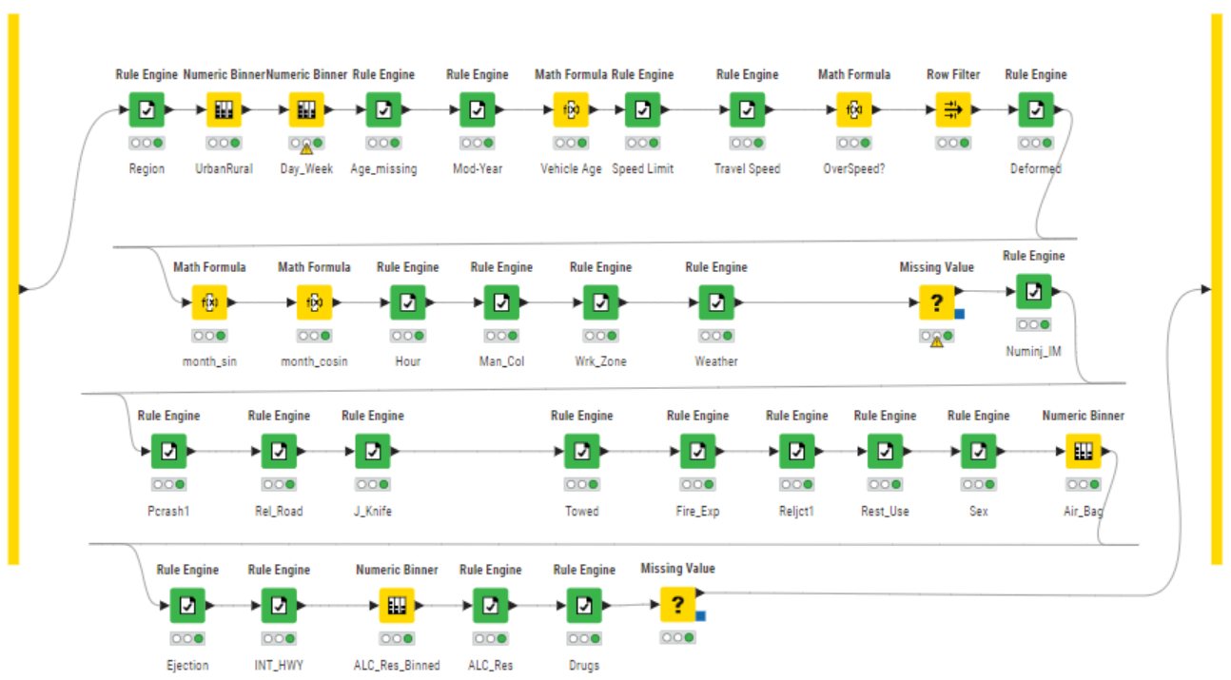
DATA PREPROCESSING
DATA TRANSFORMATION
All the variables used in our analysis was feature engineered to make them more suitable for modeling and to improve the model's predictive power
Rule Engine, Math Formula and Numeric Binner Nodes were used for this purpose

Slide 10





DATA PREPROCESSING
MISSING VALUE IMPUTATION
Numeric missing variables were imputed with the median
Categorical missing variables were imputed with a fixed value i.e. “Missing”
Missing values in the variable WRK_ZONE was imputed with rounded mean.
Missing values in the variable Trav_SP was imputed with median
Missing values in the variable VSPD_LIM was imputed with rounded mean.

Slide 11



DATA PREPROCESSING
VARIABLE SELECTION
A column filter was used to choose the variables we want to use for our prediction.
The color manager node assigned colors to our target variable.
A normalizer node was used to adjust the values in the dataset so that they share a common scale without distorting differences in the ranges of values or losing information.
List of variables used for prediction purpose
Hour
MAN_COLL
RELJCT1
REL_ROAD
WRK_ZONE
LGT_COND
WEATHER
INT_HWY
NUM_INJ
BODY_TYP
J_KNIFE
TOWED
FIRE_EXP
PCRASH1
SEX
SEAT_POS
REST_USE
EJECTION
ALC_RES
DRUGS
Region
Urban city
DAY_WEEK
Age
MOD_Year
VEH_Age
VSPD_Lim
TRAV_SP
Overspeed
Deformed
Month
AIR_BAG

Slide 12



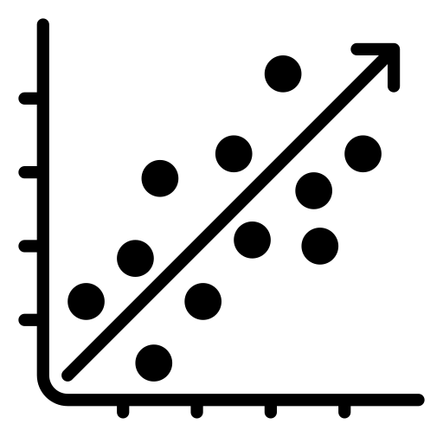


PREDICTION MODELS
NUMBER BASED MODELS
SET BASED MODELS
Naïve Bayes
Random Forest
Neural Networks
Logistic Regression
Decision Tree
Gradient Boosted Tree

Slide 13
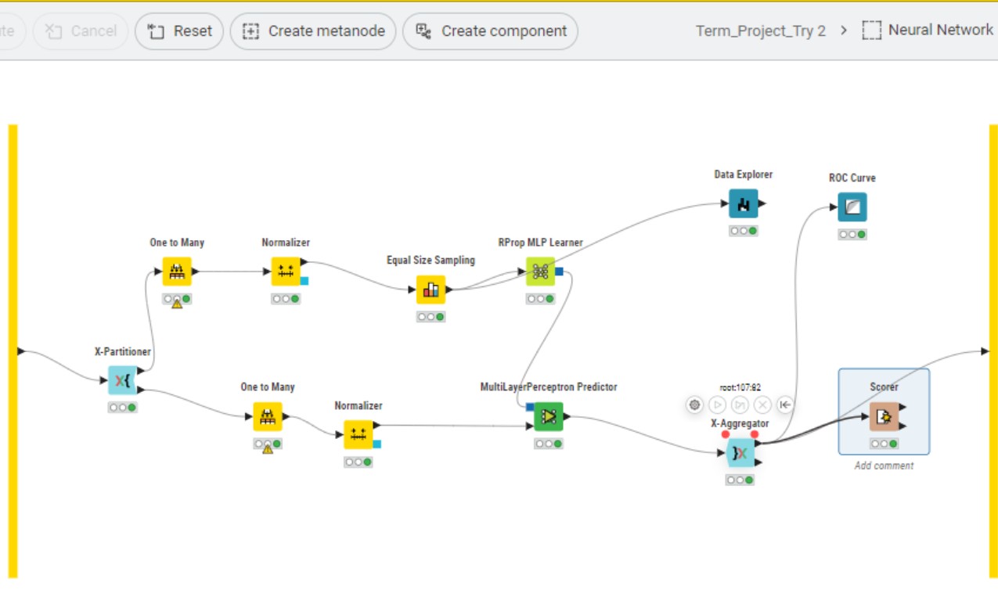
ARTIFICIAL NEURAL NETWORKS
Overview:
The Artificial Neural Network (ANN) is a computational model inspired by the biological neural networks of the human brain, designed to simulate learning and decision-making processes.
Training Process:
Trained on dataset using one-to-many conversion for categorical variables.
Normalizer used to scale numerical features for uniformity.
Employed k-fold cross-validation to assess performance and prevent overfitting.
Evaluation Metrics:
Assessed using accuracy, sensitivity, and specificity.
Leveraged k-fold cross-validation for reliable performance estimates.

Slide 14
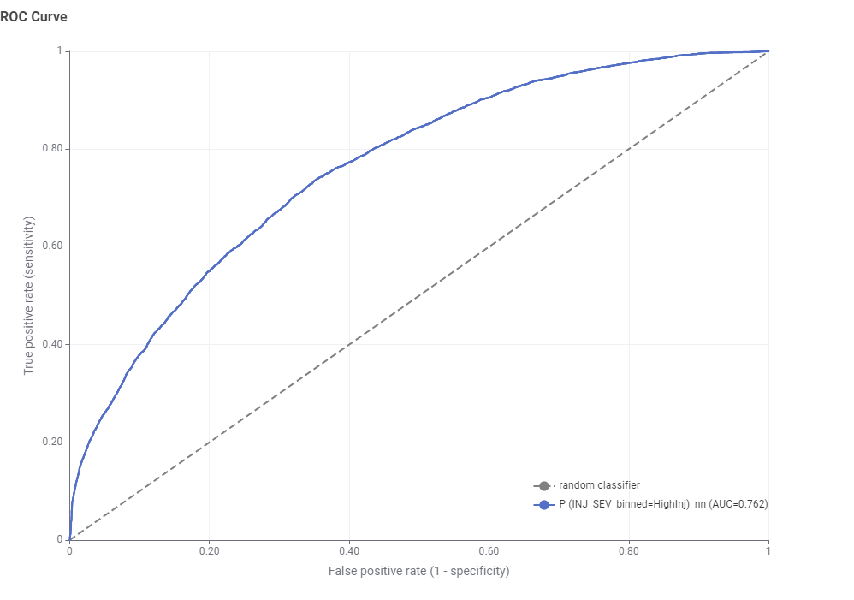
ARTIFICIAL NEURAL NETWORKS
Accuracy: 65.7%
Sensitivity: 73.1%
Specificity: 64%

Slide 15
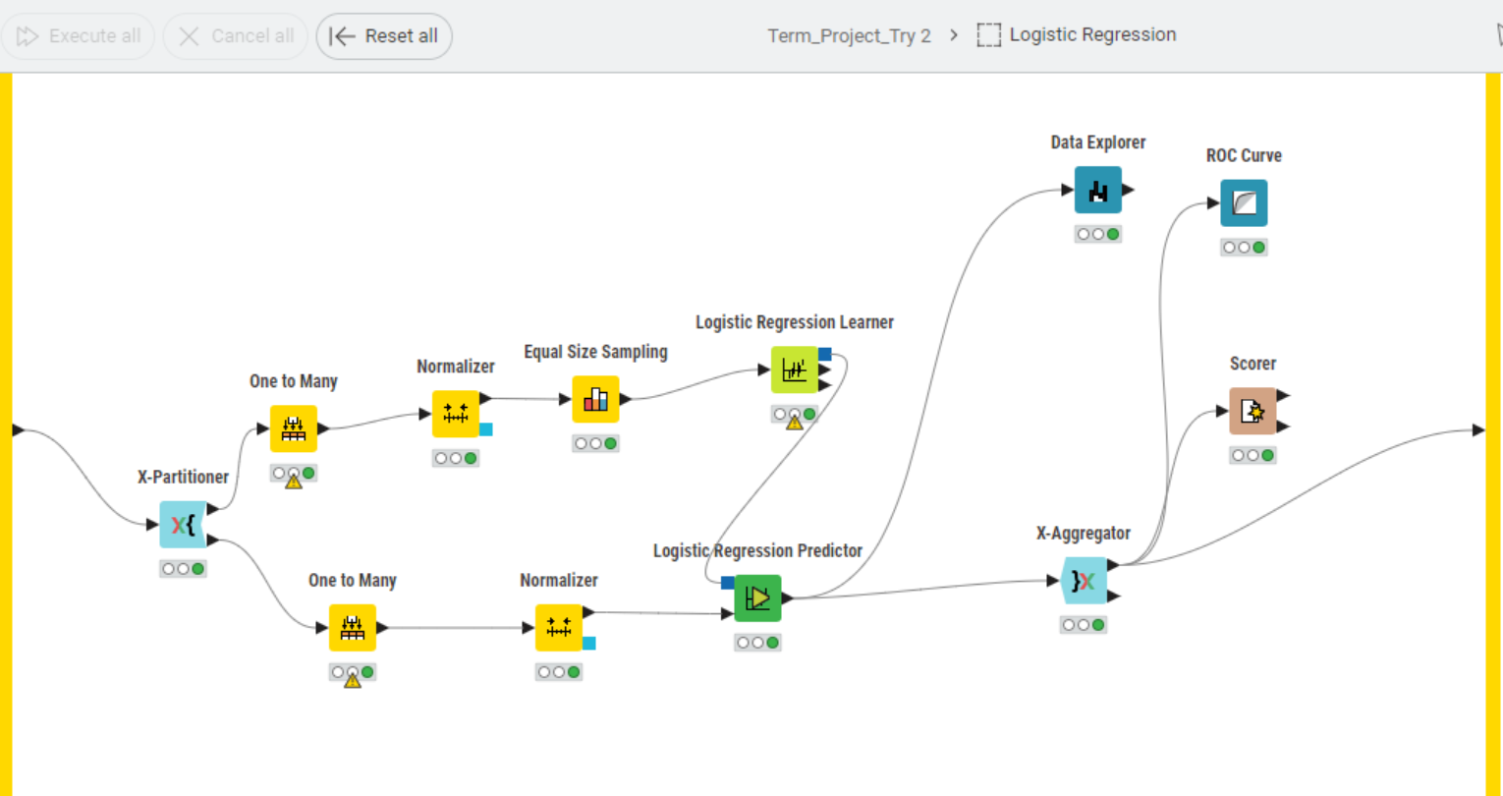
LOGISTIC REGRESSION
Overview:
Logistic regression is a statistical technique used to predict the probability of a binary outcome based on independent variables. It's suitable for scenarios with two distinct categories for the dependent variable.
Key Features:
Data preprocessing involved normalization using the normalizer node to ensure consistent feature scaling.
The x-partitioner node was used to partition the data, followed by the one-to-many node for handling categorical variables.
Equal size sampling was applied to balance class representation within the training data.
The logistic regression learner node was used to train the model on the preprocessed data.
Predictions were generated using the predictor node, following the same preprocessing steps as the training data.
Results were aggregated using the x-aggregator node for further analysis and evaluation.

Slide 16
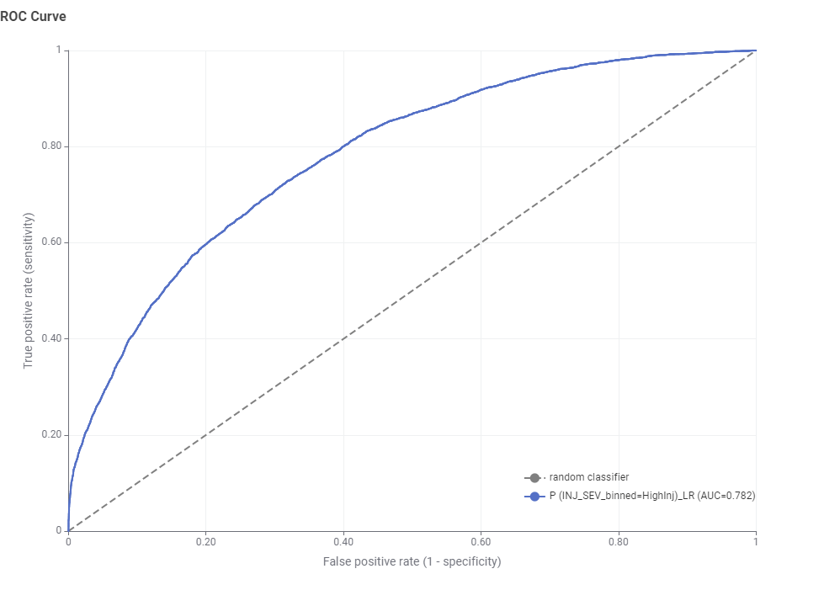
LOGISTIC REGRESSION
Accuracy: 66.8%
Sensitivity: 76%
Specificity: 64.6%

Slide 17
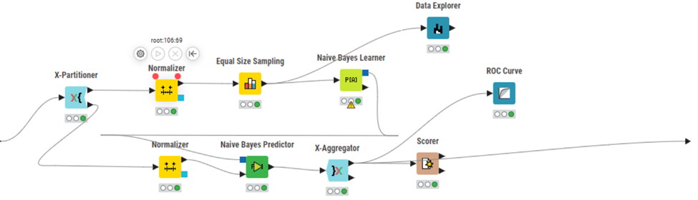
NAÏVE BAYES
Overview:
Naive Bayes is a probabilistic classifier based on Bayes' theorem, assuming independence between features, making it a simple and efficient method for classification tasks. It estimates the probability of a particular outcome (injury severity) based on the presence or absence of specific features in a data point.
Key Features:
Data for the Naive Bayes model was obtained from the color manager node, ensuring consistent preprocessing of categorical variables.
K-fold cross-validation was performed using the x-partitioner and x-aggregator nodes to robustly evaluate the model's performance.
Normalization was applied to the data using the normalizer node to ensure uniformity in feature scales.
Equal size sampling was utilized to balance class representation within the training data, enhancing model generalization.

Slide 18
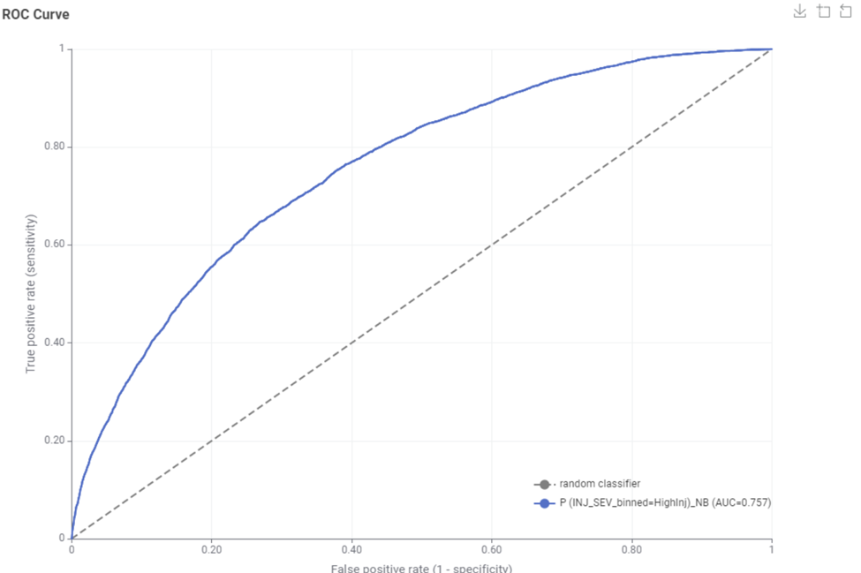
NAÏVE BAYES
Accuracy: 63.2%
Sensitivity: 77%
Specificity: 59.9%

Slide 19
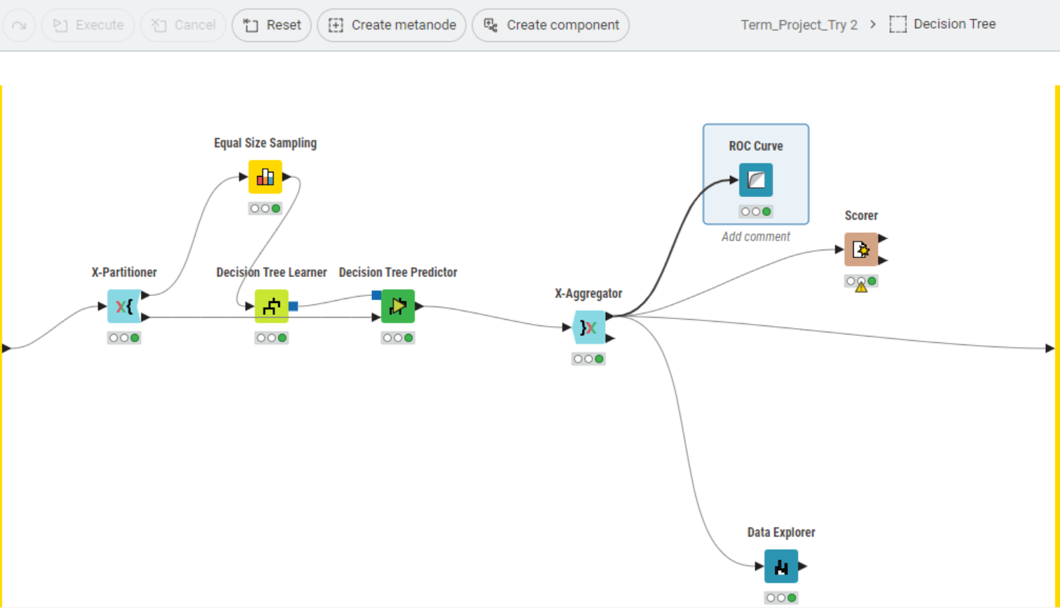
DECISION TREE
Overview:
A decision tree is a supervised learning algorithm that utilizes a tree-like structure to classify data points based on specific features. It iteratively splits the dataset into branches, with each branch representing a decision based on a feature, ultimately leading to terminal nodes (leaves) indicating the predicted outcome, such as injury severity in our case.
Key Features:
In our project, the data for the decision tree model was sourced from the normalizer node, ensuring consistent scaling of numerical features.
We employed an equal sampling approach to ensure balanced representation of different classes within the dataset.
The decision tree learner utilized a binary nominal split criterion, allowing for efficient classification based on categorical variables.
To robustly evaluate our model's performance and prevent overfitting, we employed k-fold cross-validation with a random seed of 12345, ensuring reproducibility and consistency in our results.
Additionally, we utilized stratified sampling to maintain the proportion of different classes in each fold, enhancing the reliability of our model evaluations.

Slide 20
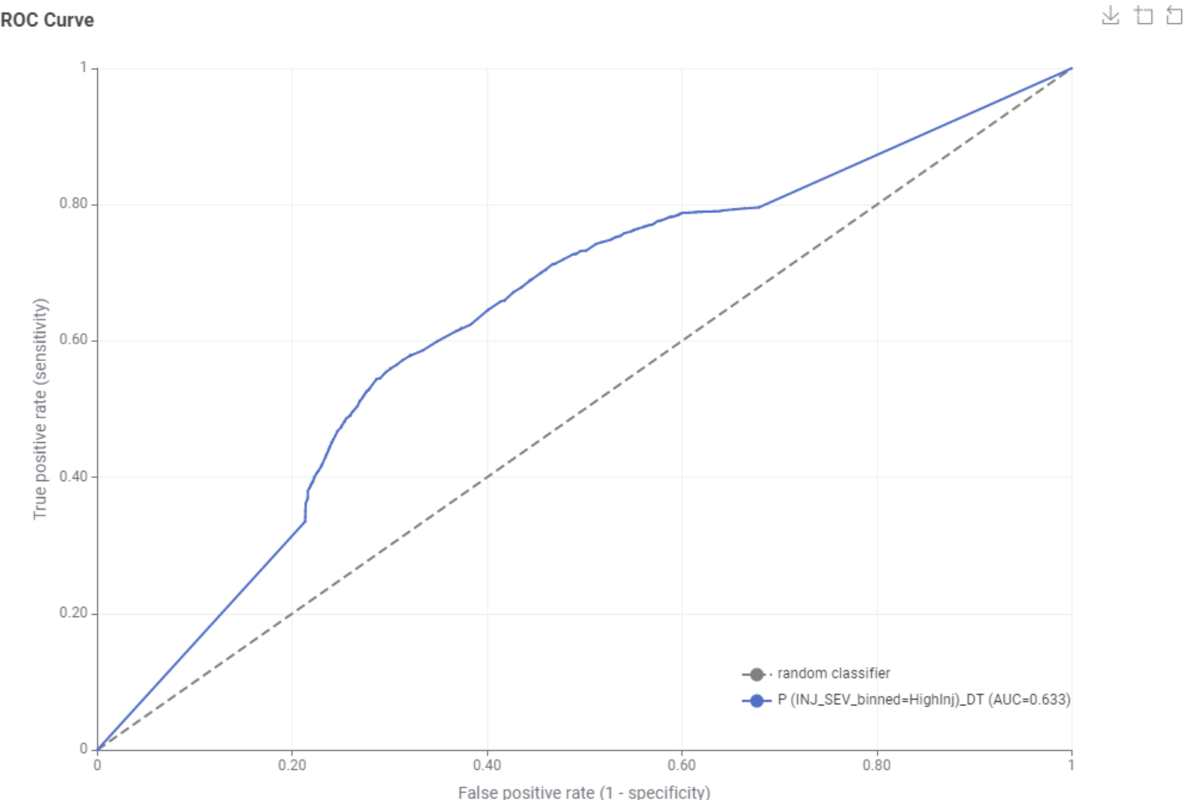
DECISION TREE
Accuracy: 62.6%
Sensitivity: 61.8%
Specificity: 62.8%

Slide 21
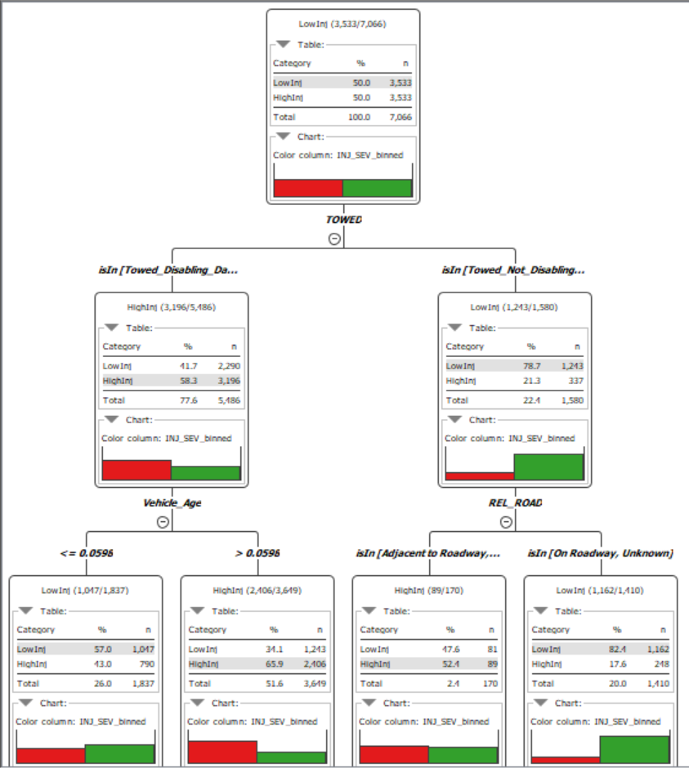
DECISION TREE
Vehicle Age: The primary factor influencing injury severity is vehicle age. Newer vehicles (age <= 0.0598) are more likely to be associated with low injuries (58.3%).
Accident Location: For older vehicles, the relation to traffic way is important. Accidents on major roads or adjacent to them are more likely to result in high injuries (21.3%).
Tow Status: For accidents on non-major roads, the tow status provides further insight. Towed vehicles are more likely to have low injuries (78.7%).

Slide 22
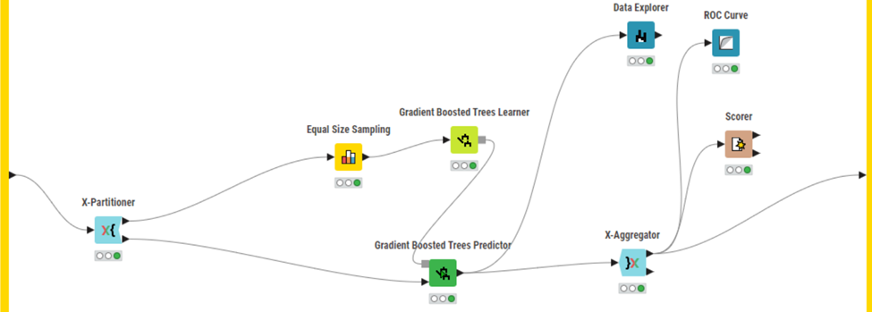
GRADIENT BOOSTING TREE
Overview:
Gradient Boosting Trees (GBT) is a powerful ensemble learning technique used for classification and regression tasks.
It constructs an ensemble of decision trees sequentially, with each tree learning from the errors of its predecessors.
Key Features
GBT builds an ensemble of decision trees sequentially, with each subsequent tree focusing on learning from the errors made by the previous ones.
In our project, we employed an equal sampling node with a random static seed of 12345 to ensure consistency in our results.
Additionally, we utilized k-fold cross-validation, with the target column being INJ_SEV_BINNED, to robustly evaluate our model's performance across different subsets of the data.

Slide 23
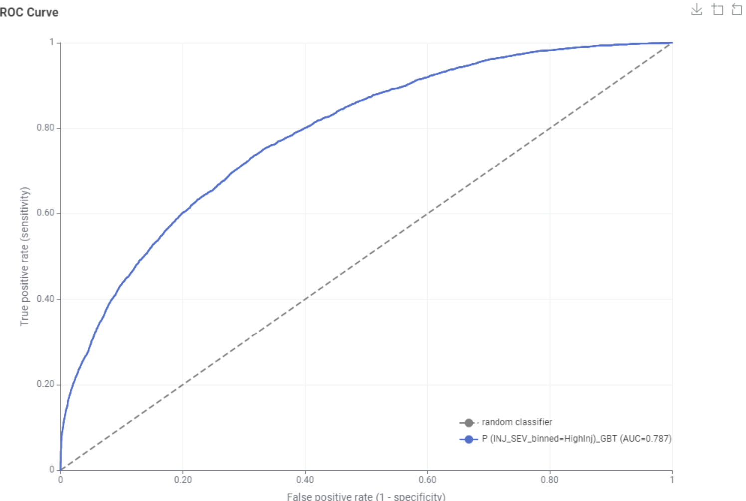
GRADIENT BOOSTING TREE
Accuracy: 70.142%
Sensitivity: 91%
Specificity: 82.3%

Slide 24
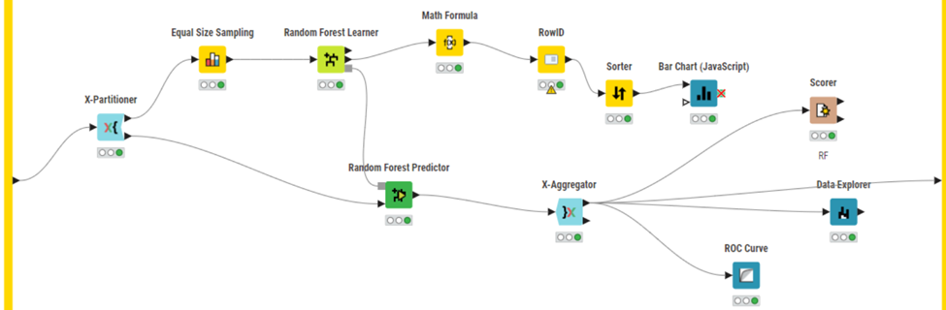
RANDOM FOREST
Overview:
Random forest is an ensemble learning technique that combines the predictions of multiple decision trees to improve predictive accuracy and reduce overfitting. Each decision tree in the ensemble is trained on a random subset of the training data and a random subset of features, resulting in a diverse set of trees.
Key Features:
Data for the random forest model was obtained from the normalizer node, ensuring consistent scaling of numerical features.
K-fold cross-validation with stratified sampling was utilized to robustly evaluate the model's performance across different subsets of the data.
An equal size sampling approach with a random seed of 12345 was employed to ensure balanced representation of classes within the training data.
The "use exact sampling" option was selected to improve the efficiency of model training by avoiding unnecessary computation.
Variable importance analysis was conducted using the random forest bar chart node from the learner node, providing insights into the significance of different features in predicting injury severity.

Slide 25
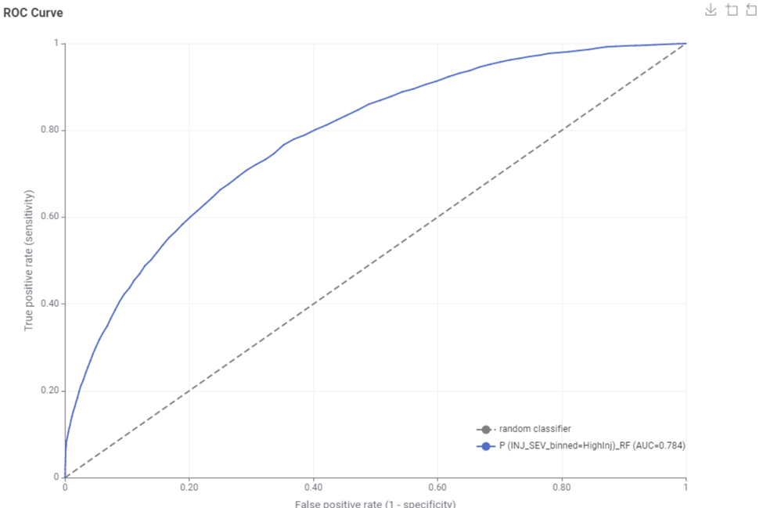
RANDOM FOREST
Accuracy: 75.3%
Sensitivity: 61.4%
Specificity: 78.5%

Slide 26
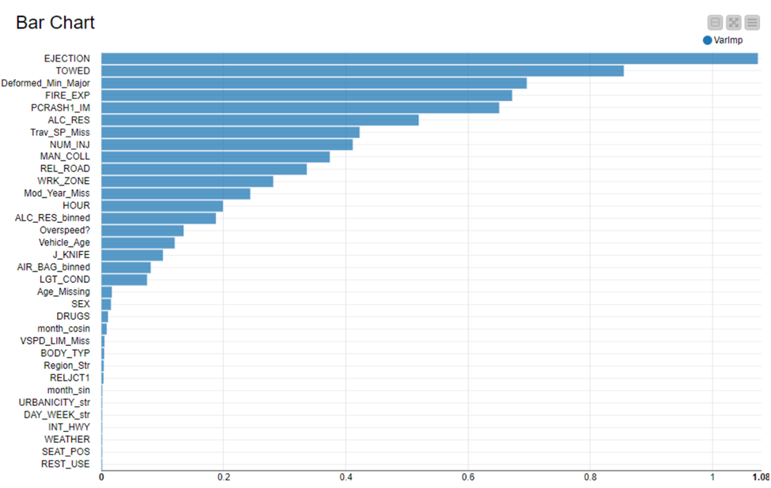
VARIABLE IMPORTANCE ANALYSIS
The "EJECTION" variable is the most important predictor in the model.
"TOWED" is the second most significant feature, indicating substantial impact on model outcomes.
Variables related to airbags and light conditions ("AIR_BAG_binned" and "LGT_COND") have moderate importance.
The least impactful variables in the model include "DAY_WEEK_str" and "INT_HWY".
Presence of missing data in some variables ("Trav_SP_Miss", "Mod_Year_Miss") is notably influential, hinting at the relevance of missingness to the prediction

Slide 27
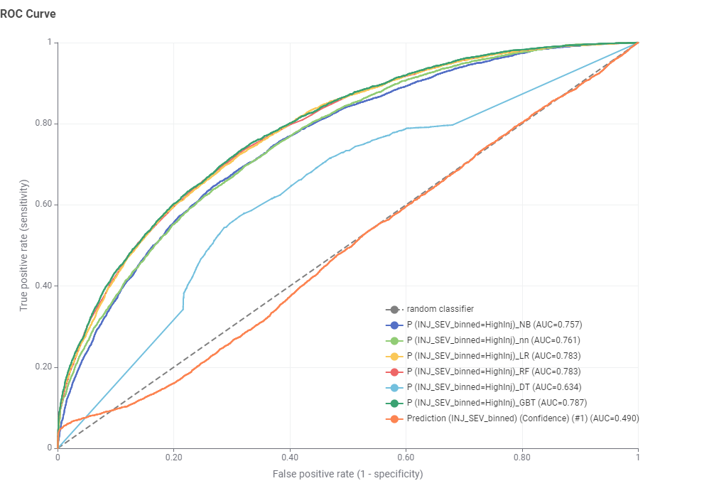
MODEL EVALUATION – ROC CURVE
Gradient Boosting Tree performs the best with AUC = 0.787.
GBT effectively distinguishes between different injury severities compared to other models.
Decision Tree has the least AUC (0.634) among the other models.

Slide 28
MODEL SUMMARY
Model | Accuracy | Sensitivity | Specificity | ROC Value
Artificial Neural Network | 65.7% | 73.1% | 64% | 76.2%
Logistic Regression | 66.8% | 76% | 64.6% | 78.2%
Naïve Bayes | 63.2% | 77% | 59.9% | 75.7%
Random Forest | 75.3% | 61.4% | 78.5% | 78.4%
Decision Tree | 62.6% | 61.8% | 62.8% | 63.4%
Gradient Boosting Tree | 70.142% | 91% | 82.3% | 78.7%

Slide 29
MODEL EVALUATION
Random Forest shows the highest accuracy of 75.3%
Gradient Boosting Tree performs the best with ROC Area under Curve of 78.7%.
Random Forest model is good at identifying minor injuries (high specificity = 78.5%) but less accurate in identifying severe injuries (lower sensitivity = 61.4%).
Gradient Boosting Tree has high specificity(82.3%) as well as high sensitivity (91%) which gives it a better ROC AUC value at an accuracy of 70.14%.
According to our analysis, Gradient Boosting Tree is the best model because it strikes a good balance between accuracy and area under the ROC curve.

Slide 30





DEPLOYMENT
Strengthening vehicle safety standards, by emphasizing on seatbelt use for ejection prevention, given its high impact on injury severity
Partnering with safety authorities and legislators to translate model insights into actionable policy improvements for road safety.
Circulating key findings to stakeholders like NHTSA to inform and adjust traffic safety regulations and emergency response strategies.
Incorporate strategies for addressing weather-related accidents and distracted driving through public campaigns and improved vehicle safety features..
Implementing a feedback mechanism to update training for emergency personnel and continuously refining the predictive model through sensitivity analysis.

Slide 31
CONCLUSION & FUTURE SCOPE
Conclusion:
The project successfully utilized decision trees, random forests, logistic regression and neural networks, with Gradient Boosting Tree achieving the highest ROC score.
Insights from the models point towards the efficacy of public education and vehicle safety enhancements in reducing injury severity.
Continuously applying these models promises to yield valuable guidance for various stakeholders.
Future Scope:
Further research could involve incorporating more diverse datasets and experimenting with advanced algorithms to improve prediction accuracy.
There's an opportunity to integrate these models into live systems for proactive risk management and to guide safety measures.

Slide 32
THANK YOU

